Slide 1

CQAVis: Visual Text Analytics for Community Question Answering
Department of Computer Science
University of British Columbia
Enamul Hoque‡, Shafiq Joty†, Lluís Màrquez† and Giuseppe Carenini‡
†ALT group, Qatar Computing Research Institute, HBKU
‡Department of Computer Science, University of British Columbia
Notes:
I’m going to present CQAVis, a visual text analytics system for supporting community question answering.
I’m Shafiq Joty; Enamul could not come, so I am gonna present on behalf of him.

Slide 2




Community Question Answering
Means for communities to share information and to collectively satisfy their information needs.
Forums organize content in the form of question–comment threads
A question posed by a user may be answered by a possibly long list of comments from other users.
Notes:
Community forums like StackExchage, Yahoo! Answers, and Quora have become very popular nowadays, where communities share information and collectively satisfy their information needs.
These forums organize content in the form of question-comment threads, where a question posed by a used may be answered by a p….

Slide 3
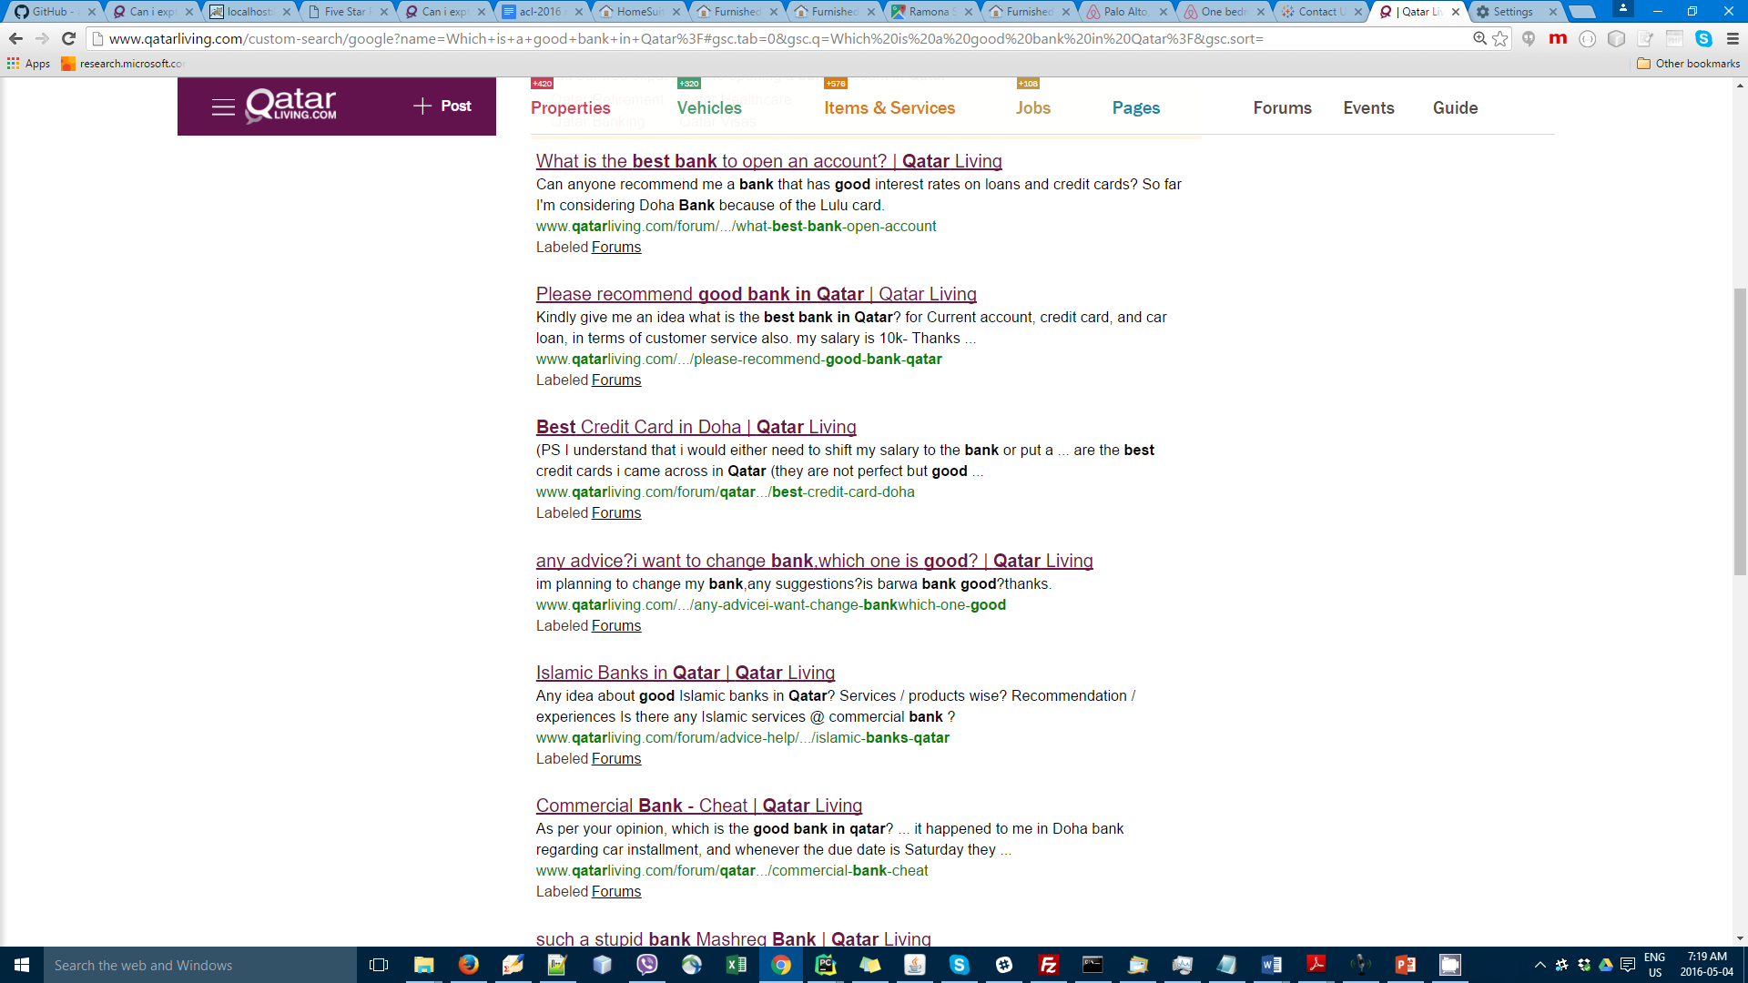
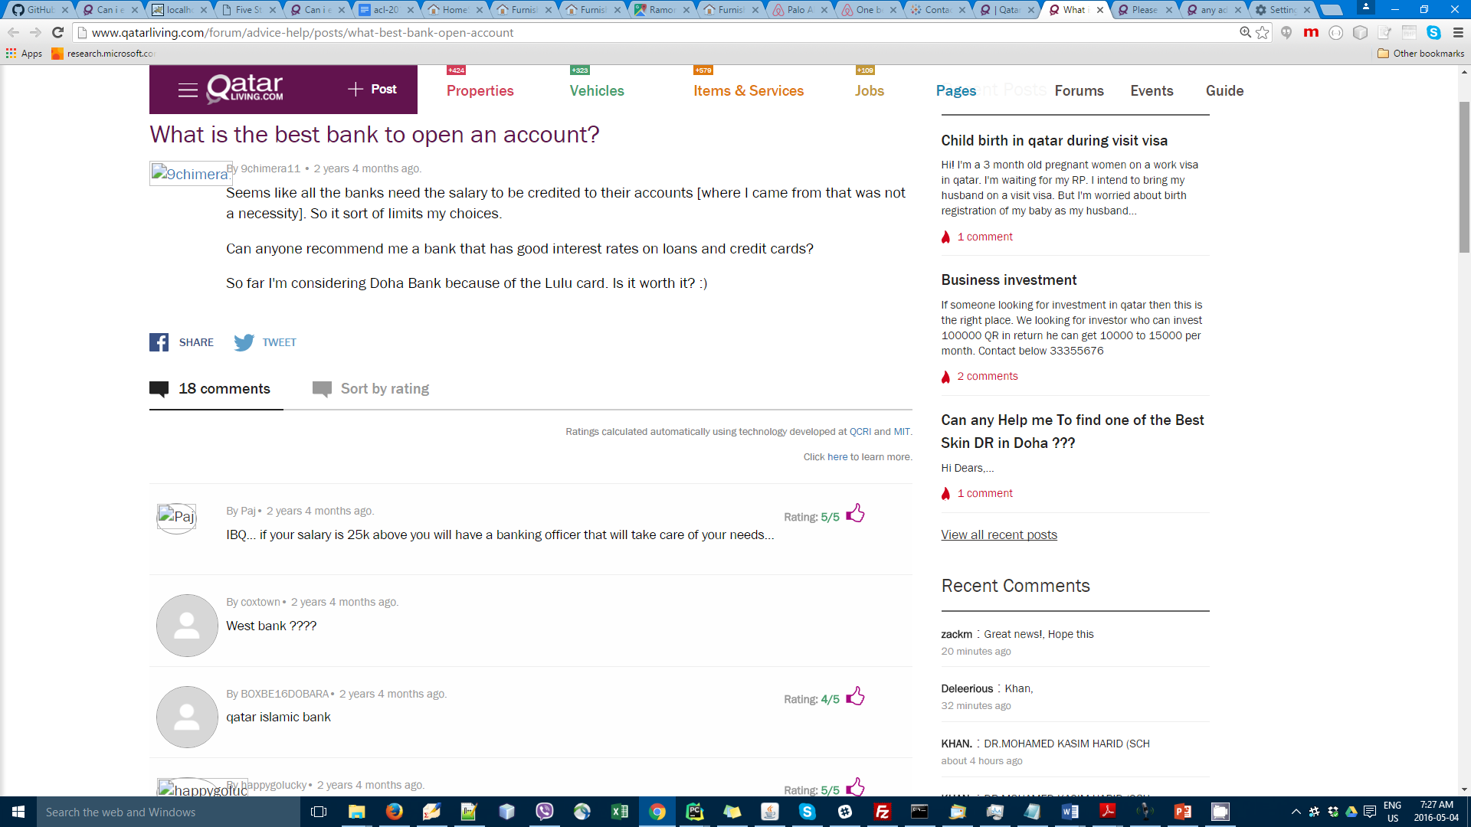
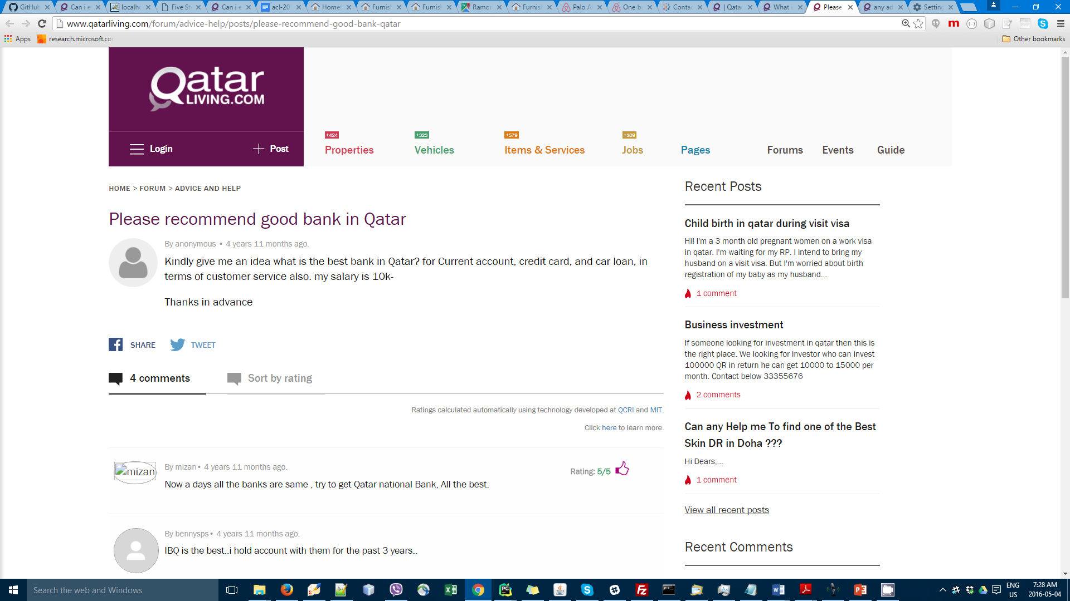
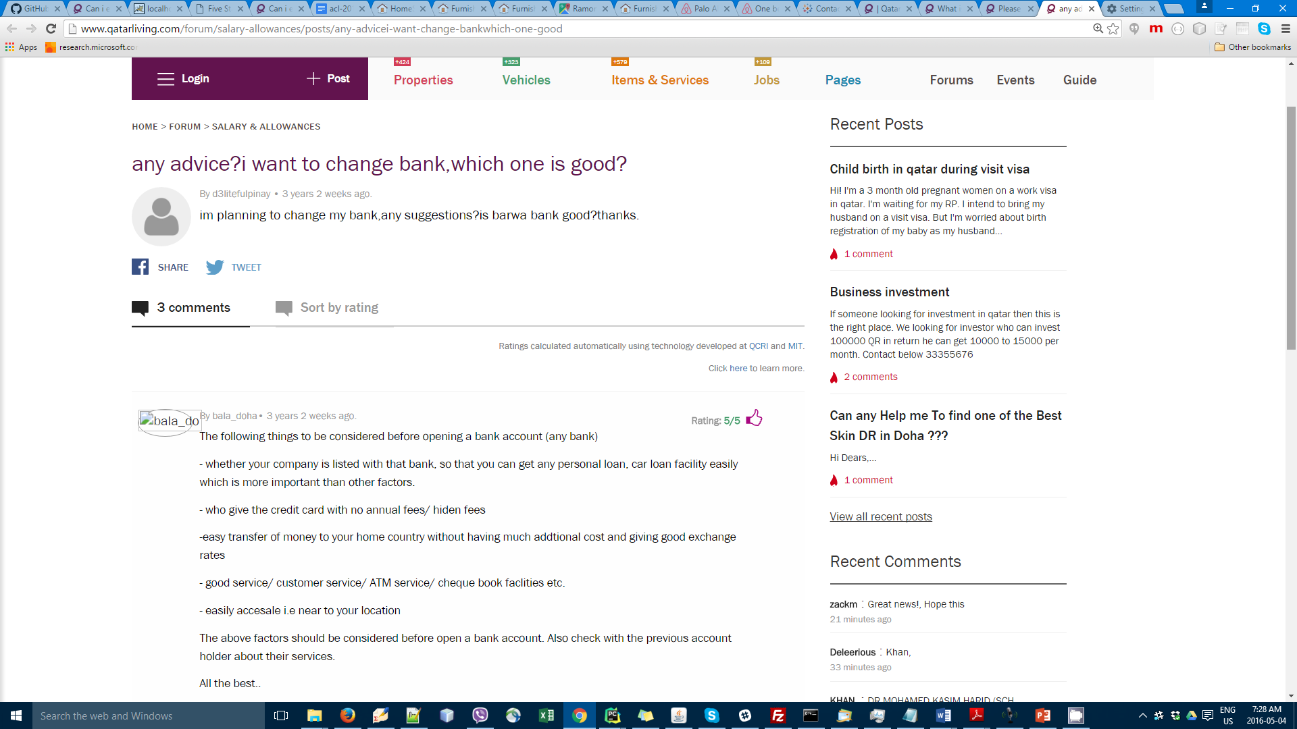
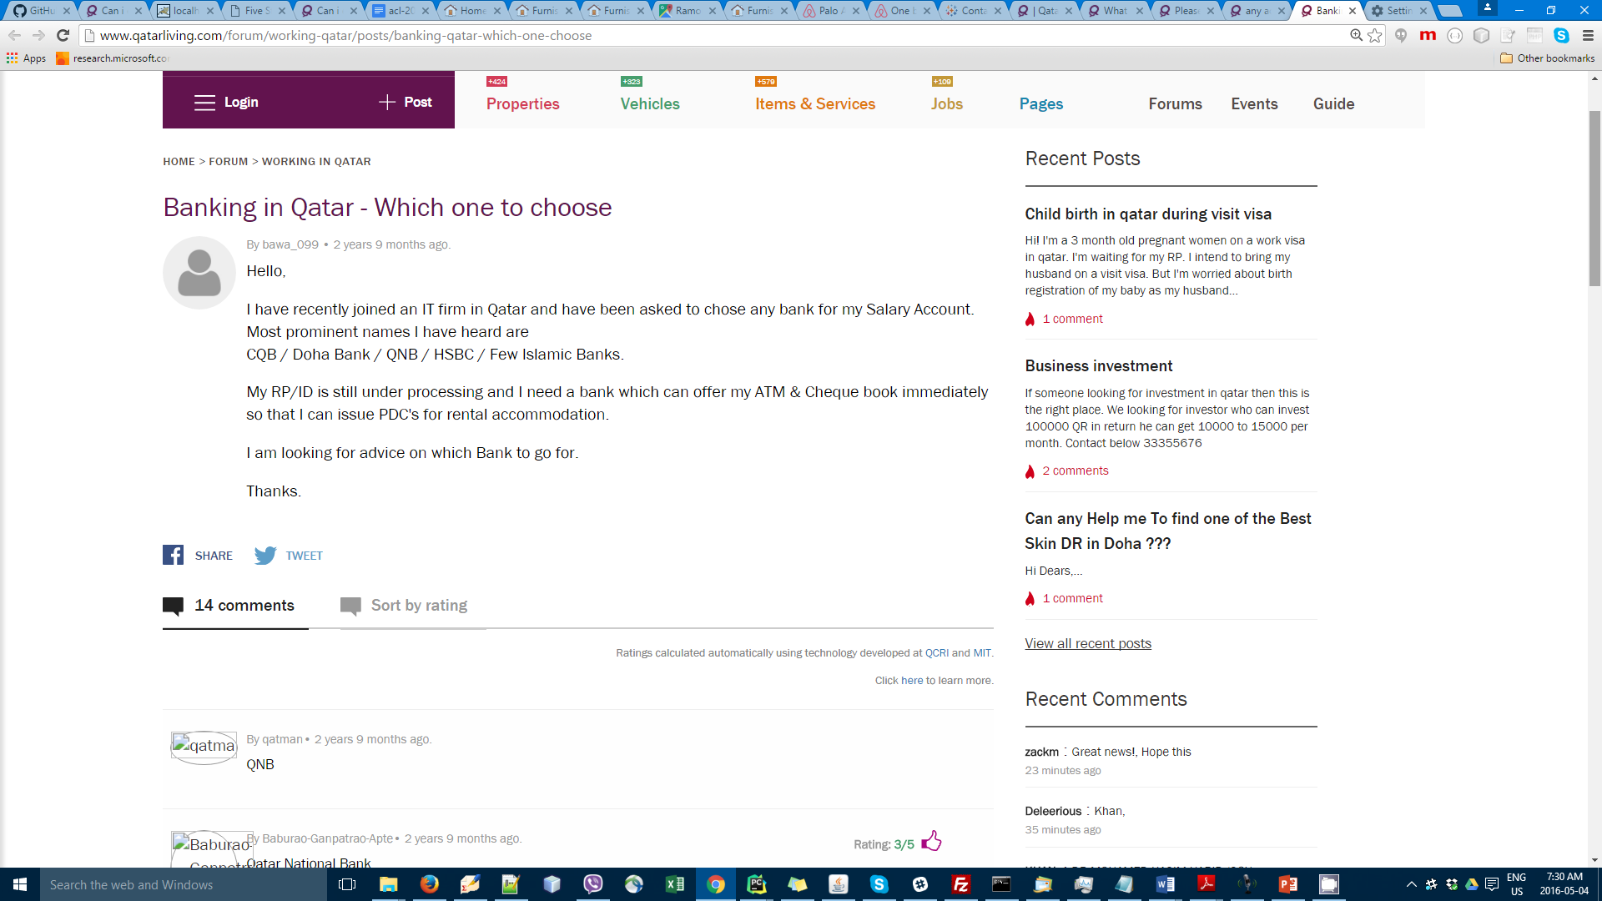
Community Question Answering: Example
Which is the best bank in Qatar?
Finding answers to a new question is challenging:
Similar questions are repeatedly posted
Long list of comments
Often redundant and noisy content
Notes:
Rather than posting the question people often search in CQA forum to find answers from previously asked questions…
For instance, consider John, who is an expatriate in Qatar arrived in Qatar and is looking for a good bank….
Given the new question… the traditional interface returns a list of previously asked questions… Each question is followed by a set of comments…

Slide 4
Our Approach
1) Combine Search and NLP techniques to:
Find related question threads in the forum
Rank the comments within each question thread
2 ) Introduce a novel interactive visual interface to:
Navigate through the comments to satisfy the information needs

Slide 5

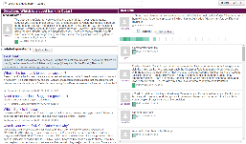


Outline
- Analyze user requirements in CQA forums
identify use cases, tasks and design needs
The system
Combine NLP and search techniques
Design CQAVis using user-centered methodologies
- Evaluate CQAVis:
- Online user study among hundreds of users in an
ecologically valid way
- Lessons learned from the study
Notes:
With this, here is the outline of today’s talk.
First, we analyze user requirements in CQA forums and identify use cases, tasks and design needs.
Then, we present the system, at the core of the system, we combine search and NLP and we design a visualization system using user-centered…
Finally, we evaluate the system with real uses and present the lessons learned..

Slide 6
User Requirements Analysis
Analyzing existing HCI literature
What types of questions are asked?
Many questions are subjective in nature
Who answers and why?
Slower responses
What is the quality of answers?
Lots of variability
Interviewing Qatar Living admins and users
Many naive users
Users want to find useful answers quickly
Difficulty in finding good answers
Screen space constraints
Summary of requirements:
We need a comment classification technique to find good answers
Interface should support users in identifying good answers quickly
Interface should be simple and intuitive.
Notes:
Need to introduce Qatar living. One of the most popular sites in Qatar, used my many expats…

Slide 7
Outline
- Analyze User requirements in CQA forums
identify use cases, tasks, and design needs
The system
Combine NLP and search techniques
Design CQAVis using user-centered methodologies
- Evaluate CQAVis:
- Online user study among hundreds of users in an ecologically valid way
- Lessons learned from the study

Slide 8
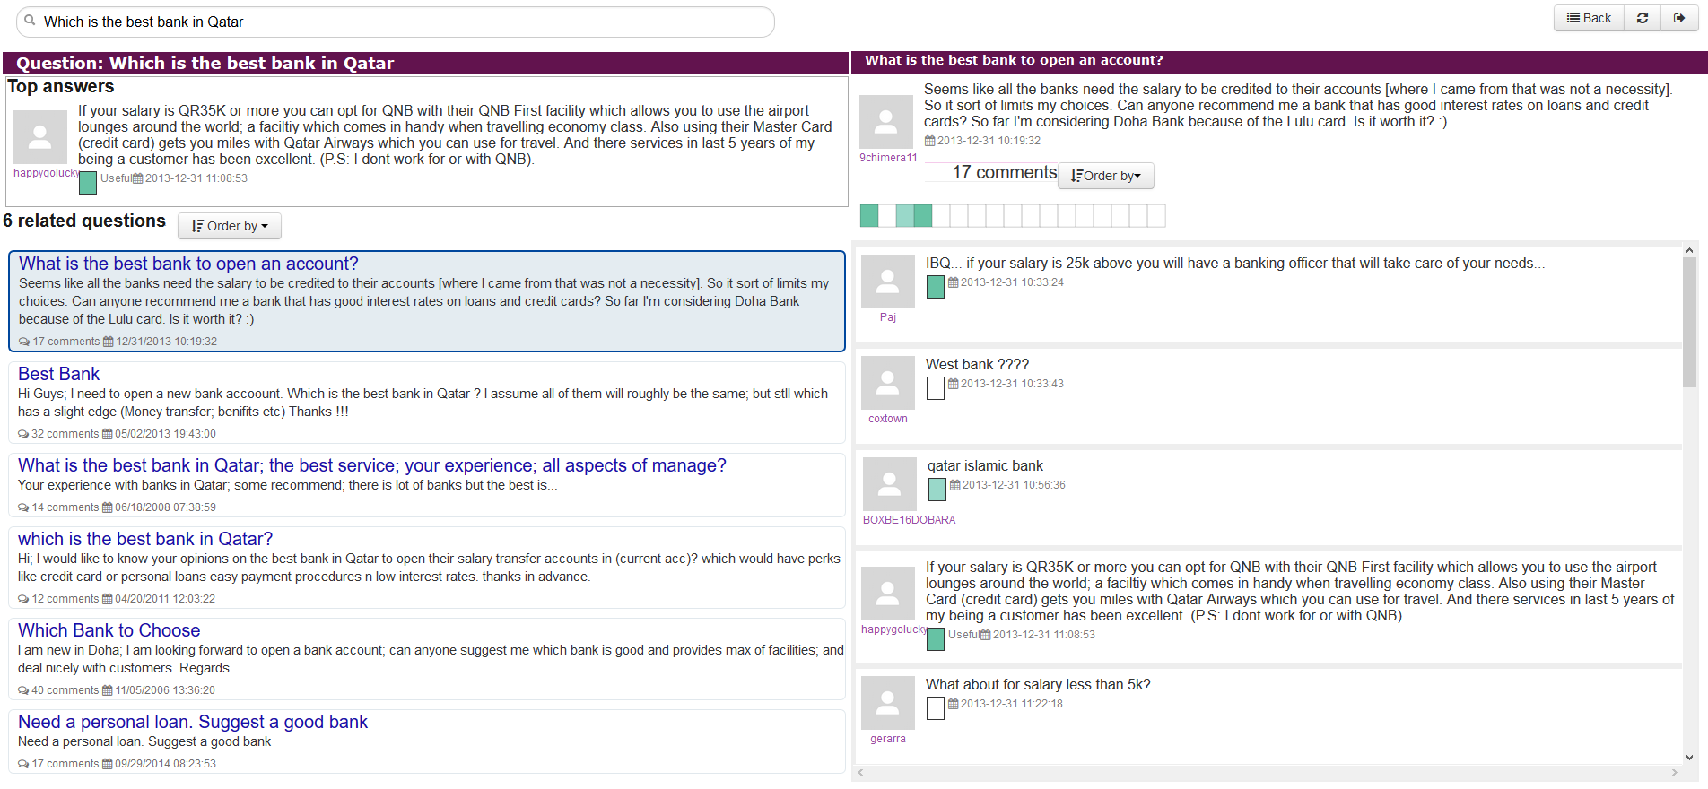
System Overview
Input question
Search engine module
Ranked question threads
Answer ranker module
Question threads with ranked list of answers
(b) Online processing
cQA Forum datasets
Trained models
QatarLiving website
Pre-processing
Presentation module
(a) Offline processing
Notes:
Here is how the overall system works. Given an input question, we first use a custom search in the Qatar Living website to retrieve a ranked list of question threads. Then a comment classifier ranks the comments in the question threads. Answer ranker module combines the question thread rank and comment classifier rank to rank the comments and pass them to the presentation module.

Slide 9
NLP Analysis: The Comment Classifier
The task: Given a thread question and a list of comments associated with it, the task of the comment classifier is to assign a relevance score to each of the comments according to their goodness at answering the thread question.
SVM Classifier:
Linear kernels over numeric and embedding features
Tree kernel over shallow syntactic trees of question and comment

Slide 10
NLP Analysis: Classification Performance
SemEval 2016 Dataset
SemEval 2016 Results
Train:
- 2,669 questions
- 17,900 comments
Test:
- 700 questions
- 7,000 comments

Slide 11
Outline
- Analyze User requirements in CQA forums
identify use cases, tasks, and design needs
The system
Combine NLP and search techniques
Design CQAVis using user-centered methodologies
- Evaluate CQAVis:
- Online user study among hundreds of users in an ecologically valid way
- Lessons learned from the study

Slide 12
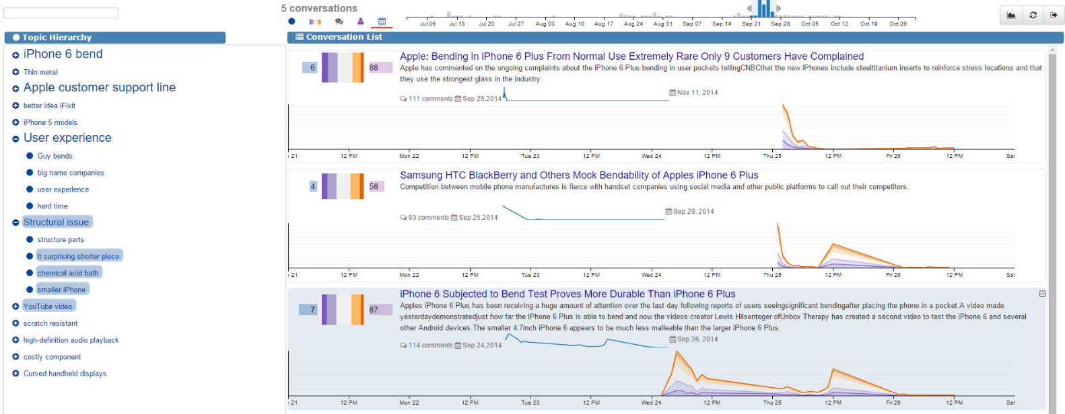
Design of CQAVis
MultiConVis
Guided by previous work on visualizing multiple conversations.
Simplified and tailored to CQA data and tasks.
Enamul Hoque and Giuseppe Carenini (IUI 2016).

Slide 13
Designing CQAVis: What Information Should be Presented?
q: Which is the best bank in Qatar?
Related question
relatedness score w.r.t. new question [0,1]
Comment
classifier score normalized to a value between [0,1]
Top answers
combine relatedness and classifier scores
q₁: what is the best bank in qatar for small business
C1₁: IBQ.if your salary is 25k above you will have…
C1₂: West bank ????
…
C1n: Thanks CBQ; I in fact applied for an account…
q₂: What is the best bank to open an account?
C2₁
C2₂
…
Qatar Living forum dump (from March 2016):
Total conversations: 202,304
Total comments: 2,043,022
Avg. comments per conversations: 10.21
C2n
…
q_{m}: Need a personal loan. Suggest a good bank
Cm₁
Cm₂
…
Cm_{n}

Slide 14
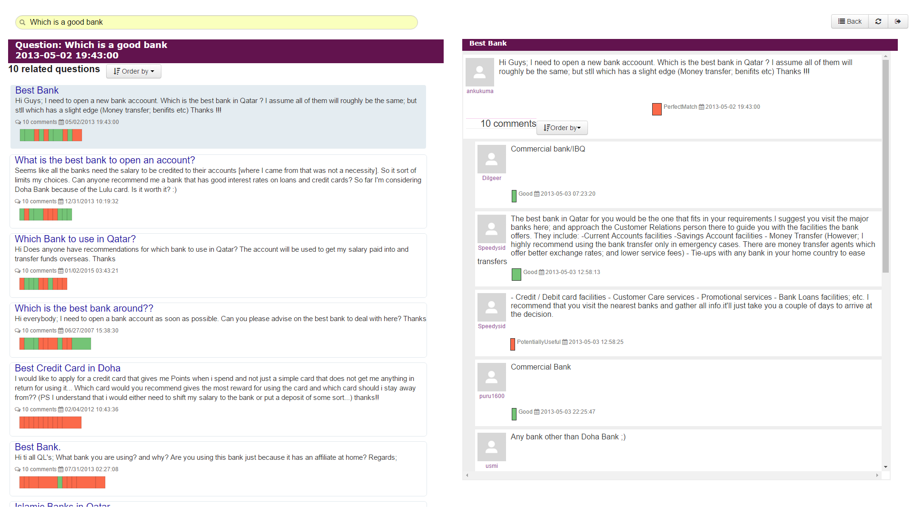
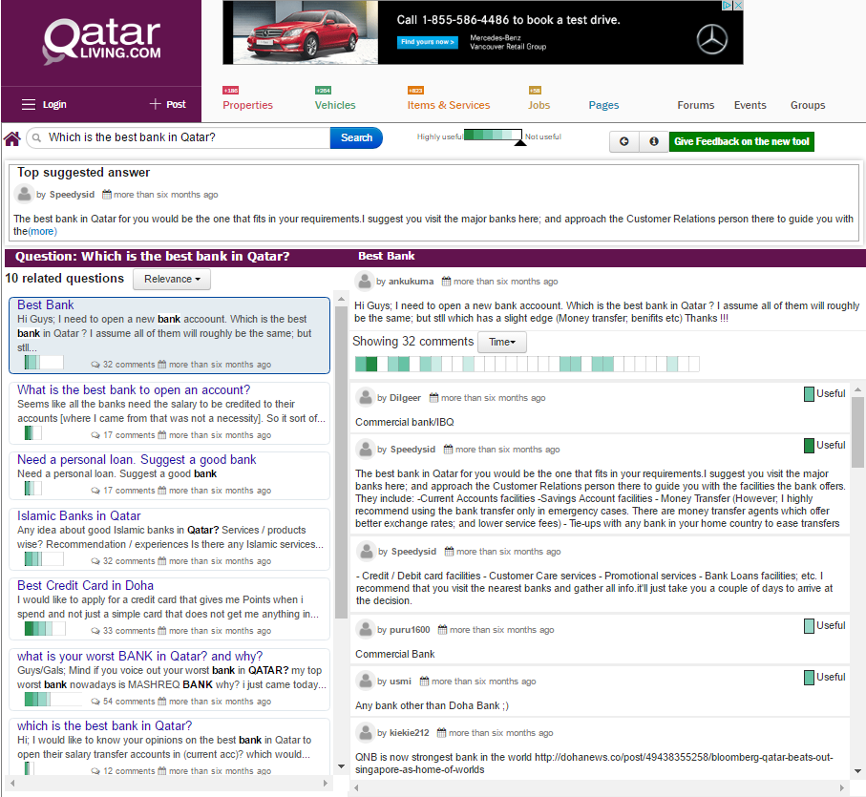
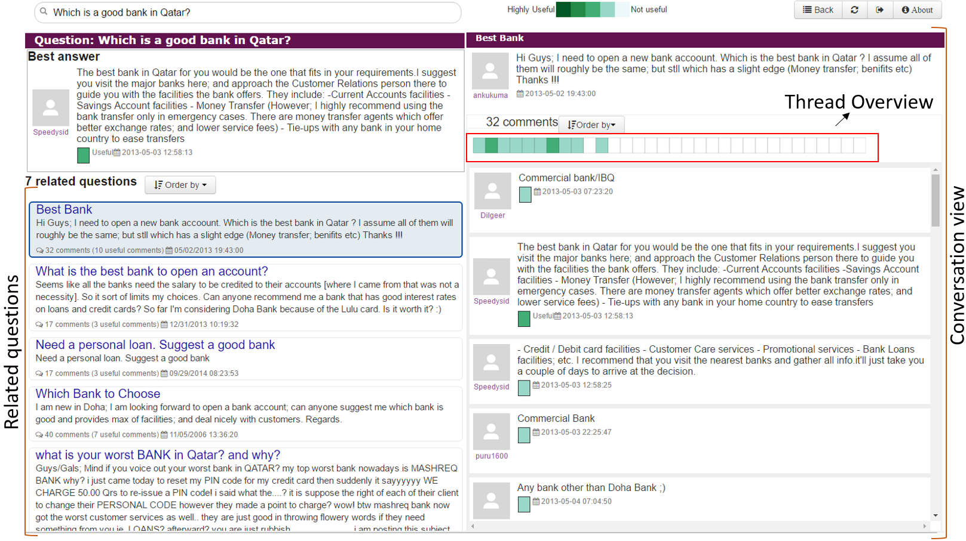
Design of CQAVis: Iterative Prototyping
V1 (based on training corpus)
V2 (first live demo)
Iyas.qcir.org/demo
V3 (Qatar Living beta version)
Qatarliving.com/betasearch
Notes:
V1: Annotated training corpus
Related questions with thread view
V2:
Thread view was moved
Simplified by removing some features that are not crucial
Used for pilot study
V3:
Deployed in the Qatar Licing forum

Slide 15
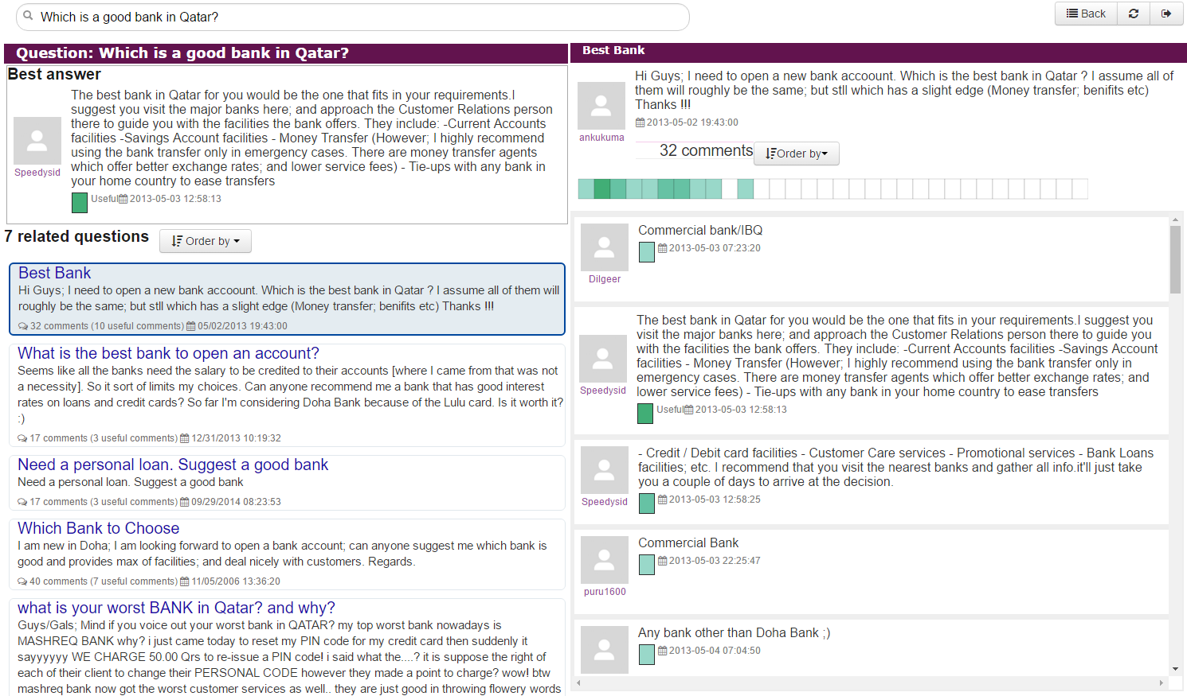
Final Design of CQAVis
Thread Overview
Conversation view
Related questions

Slide 16
Live Demo
Notes:
Video demo

Slide 17
Outline
- Analyze User requirements in CQA forums
identify use cases, tasks, and design needs
The system
Combine NLP and search techniques
Design CQAVis using user-centered methodologies
- Evaluate CQAVis:
- Online user study among hundreds of users in an ecologically valid way
- Lessons learned from the study

Slide 18
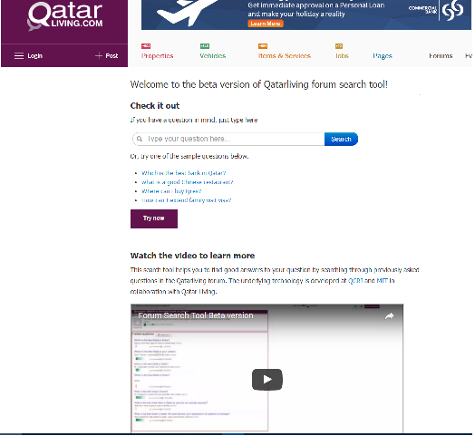
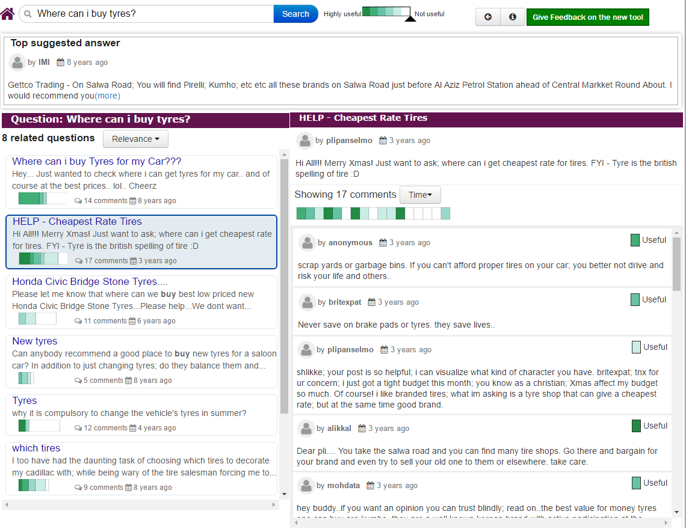
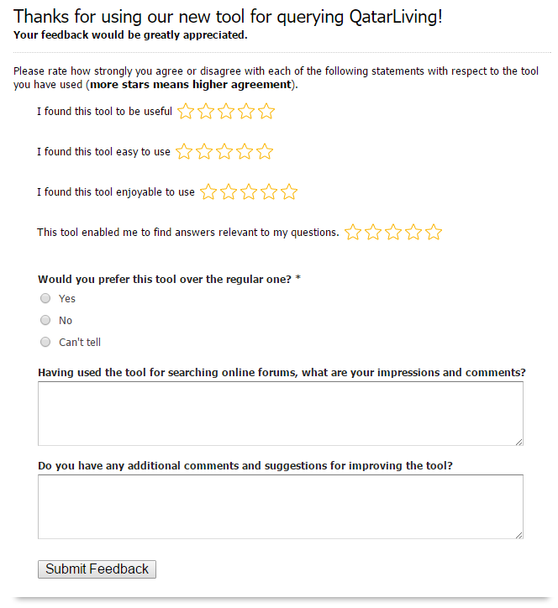
User Evaluation of CQAVis
Online User Study
Real users, real data and real tasks
- To enhance ecological validity
- Uncontrolled, less incentives for users
Pilot (lab) study
- To revise the study
Introduction
Tasks
Post-study questionnaire
http://www.Qatar Living.com/betasearch
Notes:
For evaluation we performed an online user study with real users, real data and real tasks.
Ecological validity of the tool
Challenges:
Uncontrolled
Less incentives for users

Slide 19
Online User Study: Results Analysis
User statistics:
768 participants
Data Collection:
Query log
Interface actions
Questionnaires (measured on Likert scale)
Open-ended comments
Notes:
Challenges of collecting data for online study
Lab study: Observation,

Slide 20
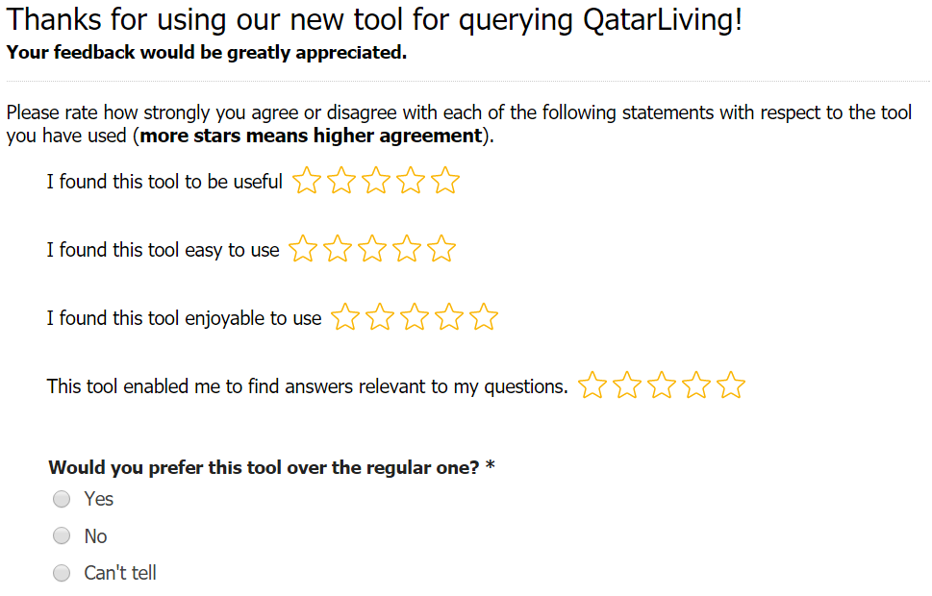
User Evaluation of CQAVis: Questionnaires
Subjective ratings
From 56 users
Would you prefer this tool over the regular one? *
Yes: 75%, No: 6.25, Can’t tell: 18.75%

Slide 21
User Evaluation of CQAVis: Interaction Statistics
Interactions in
Conversation view
Interactions in
Question list view
Time spent: 155 sec (median), 2483 sec (average)
Notes:
What percentage of users used it
On ovg freq

Slide 22
Lessons Learned
Design
Less is more
Enhance learnability
Introduce familiar visualizations
Evaluation
Challenges in collecting feedback from users
Notes:
Really critical to perform in an ecologically…..

Slide 23
Conclusions
We successfully integrate NLP and InfoVis for CQA
NLP: retrieve and rank comments given a new questions
InfoVis : helps the user in rapidly navigating the comments
Used by a population with possibly low visualization literacy
Lessons learned from the study
Future work:
Further improve the comment classifier
Apply CQAVis in other forum conversations

Slide 24
Department of Computer Science
University of British Columbia
Thank you!
Check out the live demo:
iyas.qcri.org

Slide 25
Supplementary slides

Slide 26
User requirements analysis
Analyzing Existing HCI literature
What types of questions are asked?
Many questions are subjective in nature
Who answers and why?
Slower responses
What is the quality of answers?
Lots of variability
Interviewing Qatar Living admins and users
Many naive users
Users want to find useful answers quickly
Difficulty in finding good answers
Screen space constraints
We need a comment classification technique to find good answers
(Morris et al. 2010, Ellison et al. 2013, Hecht et al. 2012)
Interface should be simple and intuitive.
Interface should support users in identifying good answers quickly
Notes:
Need to introduce Qatar living. One of the most popular sites in Qatar, used my many expats…

Slide 27
User Evaluation of CQAVis
Some qualitative feedback?
About limitations?

Slide 28
Literature Review
Conversation visualization in general
Convis and others
Specific for CQA domain

Slide 29
Future Work
Further improve the comment classifier
Apply CQAVis in other forum conversations

